Slide 1
STB
Q1 : Regression Prediction on totshopping.rep

Slide 2
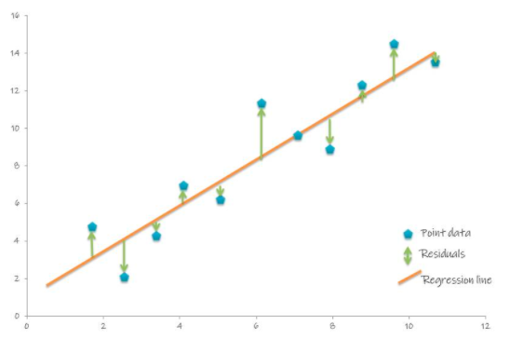
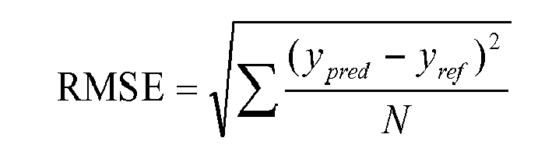
Model Approach
Linear Regression Model :
Lasso Regression
Metrics : RSME
Q1 : Prediction of totshopping.rep
Train set
14700 rows
Total Training Data
18379 rows
Lasso Model
Total Test Data
4595 rows
Valid set
3676 rows

Slide 3
STB
Q2: Classification Prediction on pov6

Slide 4
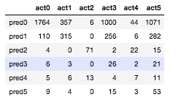
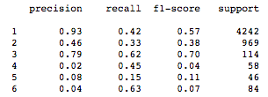
Metrics : Accuracy, Precision based on Confusion Matrix
Model Approach
Logistic Regression Model :
MultinomialNB
Q2 : classification of pov6
Train set
14700 rows
Total Training Data
18379 rows
MultinomialNB Model
Total Test Data
4595 rows
Valid set
3676 rows

Slide 5
Null Values
Outliers
Q3 : Key Points and Assumptions

Slide 6
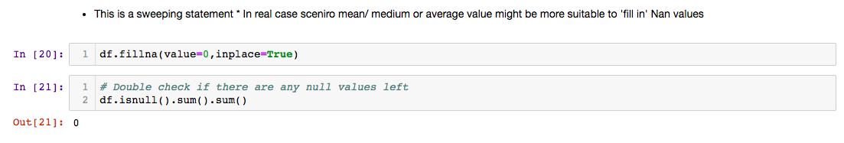
Columns with more than 90% null values are rejected
Null Values
Null Values are assumed to be zero
*Sweeping statement given the time limit*
Better Approach
Mean Value for ‘float’ type columns
mode value for categorical columns

Slide 7
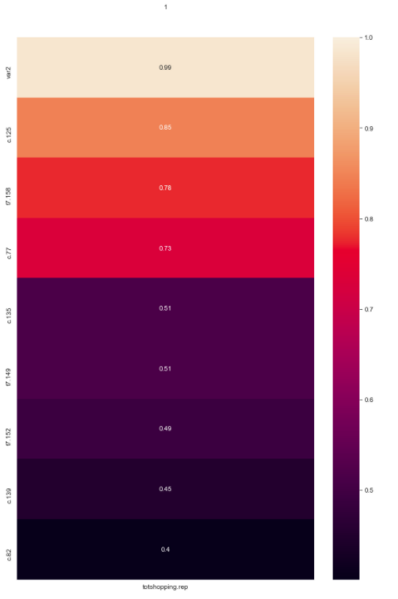
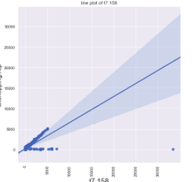
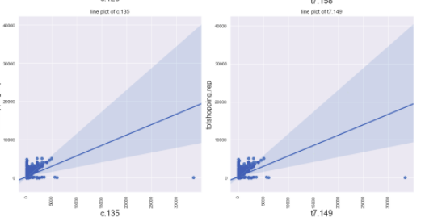

Use correlation to identify features with high correlation with ‘totshopping.rep
Heatmap
Outliers Values
Identify Outliers using Regplot

